Slide 1
Control Statements
Control statements enable us to specify
the order in which the various instructions in
the program are to be executed.

Slide 2
Introduction
In C programs, statements are executed sequentially in the order in which they appear in the program.
But sometimes we may want to use a condition for executing only a part of program.
Also many situations arise where we may want to execute some statements several times.
Control statements enable us to specify the order in which the various instructions in the program are to be executed.

Slide 3
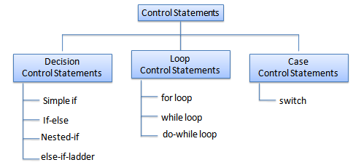
Types
This determines the flow of control. Control statements defines how to control is transferred to other parts of the program.

Slide 4
Control statements
Non-iterative
iterative
conditional
un-conditional
conditional
un-conditional
if
break
goto
for
if-else
continue
while
nested if
return
do-while
else-if ladder
switch

Slide 5
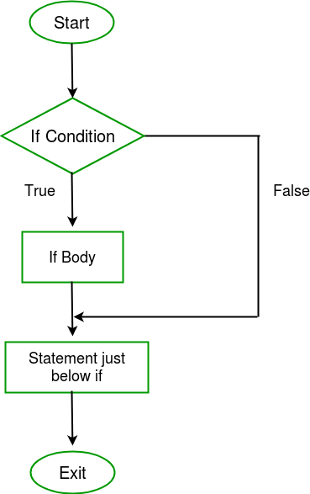
Syntax :
if(condition)
{
.......
.......
.......
}
Flow chart :
If condition
Note : if condition is true, then
It will treat that condition value
as 1 and execute the statement.
But if condition is false,
then it will treat that value as 0
and will not execute the statements.

Slide 6
Example :
If condition
int main() {
int i = 10;
if (i > 15)
{
printf("10 is less than 15");
}
printf("I am Not in if");
}
Output
I am Not in if

Slide 7
Syntax :
if(test_expression)
{
//execute your code
}
else
{
//execute your code
}
Description :
If else statements in C is also used to control the program flow based on some condition, only the difference is, it's used to execute some statement code block if the expression is evaluated to true, otherwise executes else statement code block.
If-else condition

Slide 8
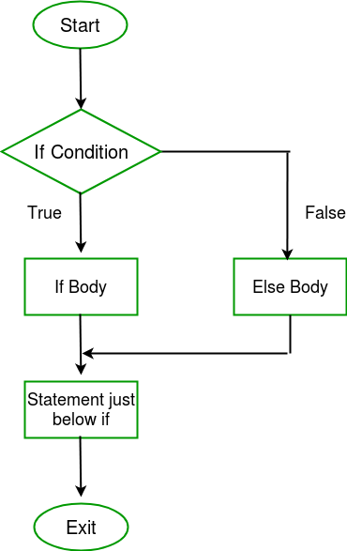
Flow chart :
If-else condition

Slide 9
Example :
If-else condition
int main() {
int i = 20;
if (i < 15)
printf("i is smaller than 15");
else
printf("i is greater than 15");
return 0;
}
Output
i is greater than 15

Slide 10
if(test_expression one)
{
if(test_expression two)
{
//Statement block Executes
}
}
else {
//stataments for else
}
Description :
Nested if else statements play an important role in C programming, it means you can use conditional statements inside another conditional statement.
Nested-if condition

Slide 11
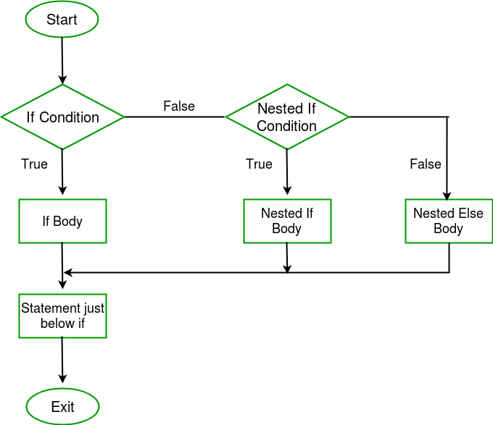
Flow chart :
Nested-If condition

Slide 12
Example :
Nested-if condition
int main(){
int i = 10;
if (i == 10)
{
// First if statement
if (i < 15)
printf("i is smaller than 15\n");
if (i < 12)
printf("i is smaller than 12 too\n");
else
printf("i is greater than 15");
}
}
Output
i is smaller than 15
i is smaller than 12 too

Slide 13
if(test_expression)
{
//execute your code
}
else if(test_expression n)
{
//execute your code
}
else
{
//execute your code
}
Description :
else-if statements in C is like another if condition, it's used in a program when if statement having multiple decisions.
else-if ladder condition

Slide 14
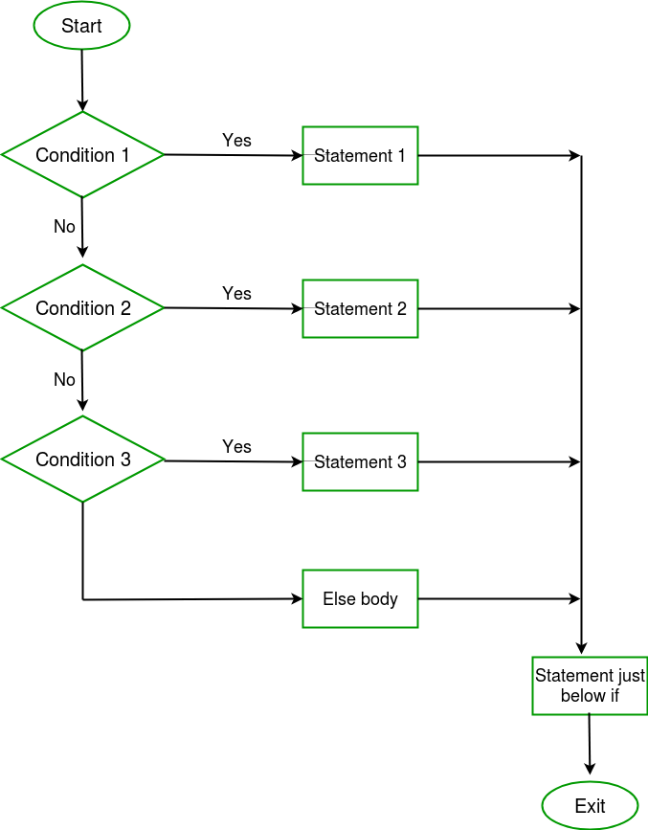
else-if ladder condition

Slide 15
Example :
else-if ladder Condition
int main() {
int i = 20;
if (i == 10)
printf("i is 10");
else if (i == 15)
printf("i is 15");
else if (i == 20)
printf("i is 20");
else
printf("i is not present");
}
Output
i is 20

Slide 16
switch (n)
{
case 1: // code to be executed if n = 1;
break;
case 2: // code to be executed if n = 2;
break;
default: // code to be executed if n doesn't match any cases
}
Description :
Switch case statements are a substitute for long if statements that compare a variable to several integral values.
The switch statement is a multi way branch statement. It provides an easy way to dispatch execution to different parts of code based on the value of the expression.
Switch is a control statement that allows a value to change control of execution.
Switch Statement in C

Slide 17
The expression provided in the switch should result in a constant value otherwise it would not be valid.
Duplicate case values are not allowed.
The default statement is optional.Even if the switch case statement do not have a default statement,
it would run without any problem.
The break statement is used inside the switch to terminate a statement sequence. When a break statement is reached, the switch terminates, and the flow of control jumps to the next line following the switch statement.
Switch Statement in C

Slide 18
Valid expressions for switch:
// Constant expressions allowed
switch(1+2+23)
switch(1*2+3%4)
// Variable expression are allowed provided
// they are assigned with fixed values
switch(a*b+c*d)
switch(a+b+c)
The break statement is optional. If omitted, execution will continue on into the next case. The flow of control will fall through to subsequent cases until a break is reached.
Nesting of switch statements are allowed, which means you can have switch statements inside another switch. However nested switch statements should be avoided as it makes program more complex and less readable
Switch Statement in C

Slide 19
Switch Statement in C

Slide 20
Example :
Switch Statement in C
int main()
{
int x = 2;
switch (x)
{
case 1: printf("Choice is 1");
break;
case 2: printf("Choice is 2");
break;
case 3: printf("Choice is 3");
break;
default: printf("Choice other than 1, 2 and 3");
break;
}
}
Output
Choice is 2

Slide 21
That are,
goto
break
continue
Return
C goto :
The goto statement in C also referred to as unconditional jump statement can be used to jump from one point to another within a function.
Jump Statements in C

Slide 22
Syntax :
Syntax1 | Syntax2
------------------------------
goto label; | label:
. | .
. | .
. | .
label: | goto label;
Description :
the first line tells the compiler to go to or jump to the statement marked as a label. Here label is a user-defined identifier which indicates the target statement.
The statement immediately followed after ‘label:’ is the destination statement.
The ‘label:’ can also appear before the ‘goto label;
goto Statement in C

Slide 23
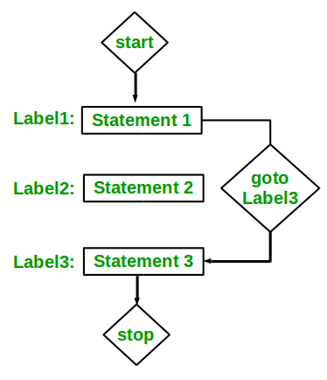
Flow chart :
goto Statement in C

Slide 24
Example :
goto Statement in C
int main()
{
printf ( “hello\n” ) ;
label: printf ( “hi\n” ) ;
ptrintf ( “goto test\n” ) ;
goto label;
printf (“after goto\n”);
}
Output
Hello
hi
goto test
hi
goto test
.
.
.

Slide 25
Loops in programming come into use when we need to repeatedly execute a block of statements.
Example:
Suppose we want to print “Hello World” 10 times. This can be done in two ways as shown below:
Iterative Method
An iterative method to do this is to write the printf() statement 10 times.
Loops in C

Slide 26
In Loop, the statement needs to be written only once and the loop will be executed 10 times as shown below.
In computer programming, a loop is a sequence of instructions that is repeated until a certain condition is reached.
An operation is done, such as getting an item of data and changing it, and then some condition is checked such as whether a counter has reached a prescribed number.
Using Loops

Slide 27
Counter not Reached :
If the counter has not reached the desired number, the next instruction in the sequence returns to the first instruction in the sequence and repeat it.
Counter reached :
If the condition has been reached, the next instruction “falls through” to the next sequential instruction or branches outside the loop..
Using Loops

Slide 28
There are mainly two types of loops :
Entry Controlled loops :
In this type of loops the test condition is tested before entering the loop body. For Loop and While Loop are entry controlled loops.
Exit Controlled Loops:
In this type of loops the test condition is tested or evaluated at the end of loop body. Therefore, the loop body will execute atleast once, irrespective of whether the test condition is true or false. do – while loop is exit controlled loop.
Types of Loops

Slide 29
That are,
while
do ... while
for
while :
The while loop in C is used in situations where we do not know the exact number of iterations of loop beforehand. The loop execution is terminated on the basis of the test condition.
Suppose, we want to print "He is the best" 10 times. One way to get the desired output. We write 10 printf statements, which is not preferable.
Other way out is - use loop.
Iterative loop statements in C

Slide 30
Syntax :
while (test_expression)
{
// statements
update_expression;
}
The various parts of the While loop are :
Test Expression :
In this expression we have to test the condition. If the condition evaluates to true then we will execute the body of the loop and go to update expression.
Otherwise, we will exit from the while loop.
While loop in C

Slide 31
Example:
i <= 10
Update Expression: After executing the loop body, this expression increments/decrements the loop variable by some value.
Example:
i++;
While loop in C

Slide 32
Control falls into the while loop.
The flow jumps to Condition
Condition is tested.
If Condition yields true, the flow goes into the Body.
If Condition yields false, the flow goes outside the loop
4)The statements inside the body of the loop get executed.
5)Updation, takes place.
6)Control flows back to Step 2.
7)The do-while loop has ended and the flow has gone outside.
How does a While loop executes?

Slide 33
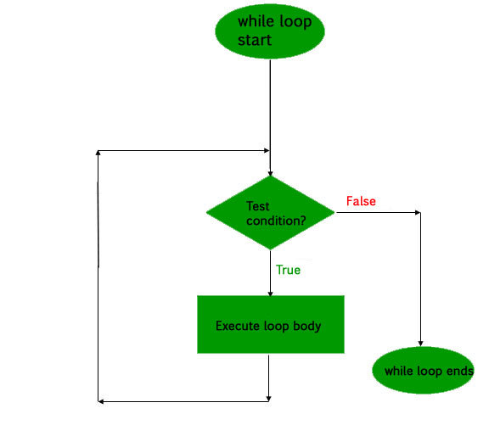
While loop in C

Slide 34
Example :
While loop in C
int main()
{
int i = 1;// Initialization expression
while (i < 6)
{
// loop body
printf("Hello World\n");
// update expression
i++;
}
}
Output
Hello World
Hello World
Hello World
Hello World
Hello World

Slide 35
Syntax :
initialization expression;
do
{
// statements
update_expression;
} while (test_expression);
Note: Notice the semi – colon(“;”) in the end of loop.
Description :
In do while loops also the loop execution is terminated on the basis of test condition. The main difference between do while loop and while loop is in do while loop the condition is tested. At the end of loop body, i.e do while loop is exit controlled whereas the other two loops are entry controlled loops.
Note:
In do while loop the loop body will execute at least once irrespective of test condition.
do .. while loop in C

Slide 36
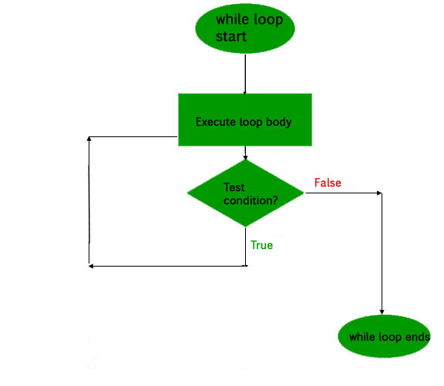
do while loop in C

Slide 37
Example :
do while loop in C
int main()
{
int i = 2; // Initialization expression
do
{
// loop body
printf( "Hello World\n");
// update expression
i++;
} while (i < 1); // test expression
}
Output
Hello World

Slide 38
Syntax :
for (initialization expr; test expr; update expr)
{
// body of the loop
// statements we want to execute
}
Description :
A for loop is a repetition control structure which allows us to write a loop that is executed a specific number of times. The loop enables us to perform n number of steps together in one line.
In for loop, a loop variable is used to control the loop. First initialize this loop variable to some value, then check whether this variable is less than or greater than counter value. If statement is true, then loop body is executed and loop variable gets updated . Steps are repeated till exit condition comes.
for loop in C

Slide 39
Initialization Expression :
In this expression we have to initialize the loop counter to some value.
Example :
int i=1;
Test Expression :
In this expression we have to test the condition. If the condition evaluates to true then we will execute the body of loop and go to update expression otherwise we will exit from the for loop.
Example :
i <= 10;
Update Expression:
After executing loop body this expression increments/decrements the loop variable by some value. for example: i++;
for loop in C

Slide 40
for loop in C

Slide 41
Example :
for loop in C
int main()
{
int i=0;
for (i = 1; i <= 5; i++)
{
printf( "Hello World\n");
}
return 0;
}
Output
Hello World
Hello World
Hello World
Hello World
Hello World

Slide 42
What about an Infinite Loop?
An infinite loop (sometimes called an endless loop ) is a piece of coding that lacks a functional exit so that it repeats indefinitely. An infinite loop occurs when a condition always evaluates to true. Usually, this is an error.
Example :
int main ()
{
int i;
for ( ; ; )
{
printf("This loop will run forever.\n");
}
Output:
This loop will run forever.
This loop will run forever.
…..........
…..........
Infinite loop in C

Slide 43
Syntax :
break;
Description :
This loop control statement is used to terminate the loop. As soon as the break statement is encountered from within a loop, the loop iterations stops there and control returns from the loop immediately to the first statement after the loop.
Basically break statements are used in the situations when we are not sure about the actual number of iterations for the loop or we want to terminate the loop based on some condition.
break statement in C

Slide 44
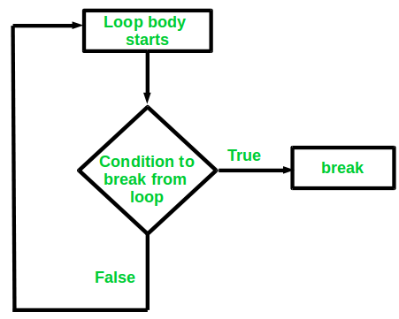
Flow chart :
break statement in C

Slide 45
Example :
break statement in C
int main()
{
Int i ;
for (i = 1; i < 3; i++)
{
printf( "Test1\n");
printf( "i=%d\n",i);
break;
}
printf( "i=%d\n",i);
}
Output
Test1
1
Test1
2
3

Slide 46
Explanation : Once in a loop break is executed then the condition will come out of loop.
Example :
break statement in C
int main()
{
Int I = 2 ;
if ( i < 5 )
break ;
else
printf( "Hello\n");
printf( "i=%d\n",i);
}
Output
Compile time error
Note : break should be used only in loops and switch
case

Slide 47
Syntax :
return;
Return
Control return Value return
( control with value return )
return statement in C

Slide 48
Description :
The return in C returns the flow of the execution to the function from where it is called.
This statement does not mandatory need any conditional statements. As soon as the statement is executed, the flow of the program stops immediately and return the control from where it was called.
The return statement may or may not return anything for a void function, but for a non-void function, a return value is must be returned
Return is used in functions, In a function once return is executed, control is back to whoever called that function.
Main also one function called by _start function.
Return is exclusively used for functions.
return statement in C

Slide 49
Example :
return statement in C
int main()
{
printf( "Hi\n");
return;
printf( "Hello\n");
}
Output
Hi

Slide 50
Syntax :
continue;
Description :
Continue is exclusively used in loops.
In a program, If we use continue, the loop is continued till the condition is false.
This loop control statement is just like the break statement. The continue statement is opposite to that of break statement, instead of terminating the loop, it forces to execute the next iteration of the loop.
As the name suggest the continue statement forces the loop to continue or execute the next iteration. When the continue statement is executed in the loop, the code inside the loop following the continue statement will be skipped and next iteration of the loop will begin.
continue statement in C

Slide 51
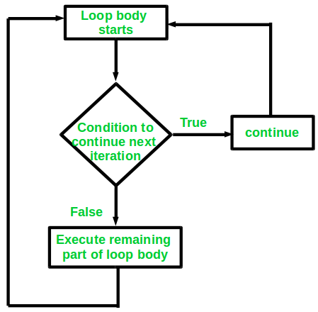
Flow chart :
continue statement in C

Slide 52
Example :
continue statement in C
int main()
{
for (i = 1; i < 3; i++)
{
printf( "Hello\n");
continue
Printf(“Hi\n”);
}
printf( "After loop\n”);
}
Output
Hello
Hello
Hello
After loop

Slide 53
Syntax :
for ( initialization; condition; increment )
{
for ( initialization; condition; increment )
{
// statement of inside loop
}
// statement of outer loop
}
Description :
Nested loop means a loop statement inside another loop statement. That is why nested loops are also called as “loop inside loop“.
Nested for loop in C

Slide 54
Example :
Nested for loop in C
int main()
{
Int I, j ;
for (i = 1; i < 2; i++)
{
printf( “three\n”) ;
for (j = 1; j < 2; j++)
{
printf( “one\n”) ;
printf( “two\n”) ;
}
}
}

Slide 55
output :
Nested for loop in C
Three
One
Two
One
Two
Three
One
Two
Two

